Slide 1
PREDICTING CAR ACCIDENT SEVERITY
ANDRÉS MORA
22.sep.2020

Slide 2
INTRODUCTION
Local government institutions are accountable for organizing traffic circulation and guaranteeing traffic safety in their respective jurisdictions.
A long held intuition supposes that car accident severity can worsen given certain environmental conditions, like those related to weather, lighting, or the road conditions. Were this true, government institutions could use such to design and implement traffic safety regulations with environmental conditions in regard.
This is of special relevance when dealing with the most unfortunate traffic-related occurrence:
CAR ACCIDENTS
So: can environmental conditions predict the severity of a car accident?

Slide 3
DATA
SOURCE
Car accident data registered by the Seattle, WA jurisdiction since 2004 until now
CLEANING
1) Identify target variable: ‘Car Accident Severity’
2) Identify independent variables:
Environmental features: ‘Weather’, ‘Lighting Conditions’, and ‘Road Conditions’
Administered by the SDOT (Seattle Department of Transportation) and the organization Traffic Records Group
Open to public
3) Drop missing data, and data labeled as ‘unknown’ or ‘other’
Final dataset: 169,949 car accidents

Slide 4
METHODOLOGY
CATEGORICAL ANALYSIS: Proposal
1) visualizing frequencies
a count-plot in to visually recognize frequency distribution
2) applying categorical correlation metrics
a Chi-square test and a Cramer’s V to obtain association and strength of association
2) obtaining distribution percentages
a contingency table to demonstrate numerically such distribution

Slide 5
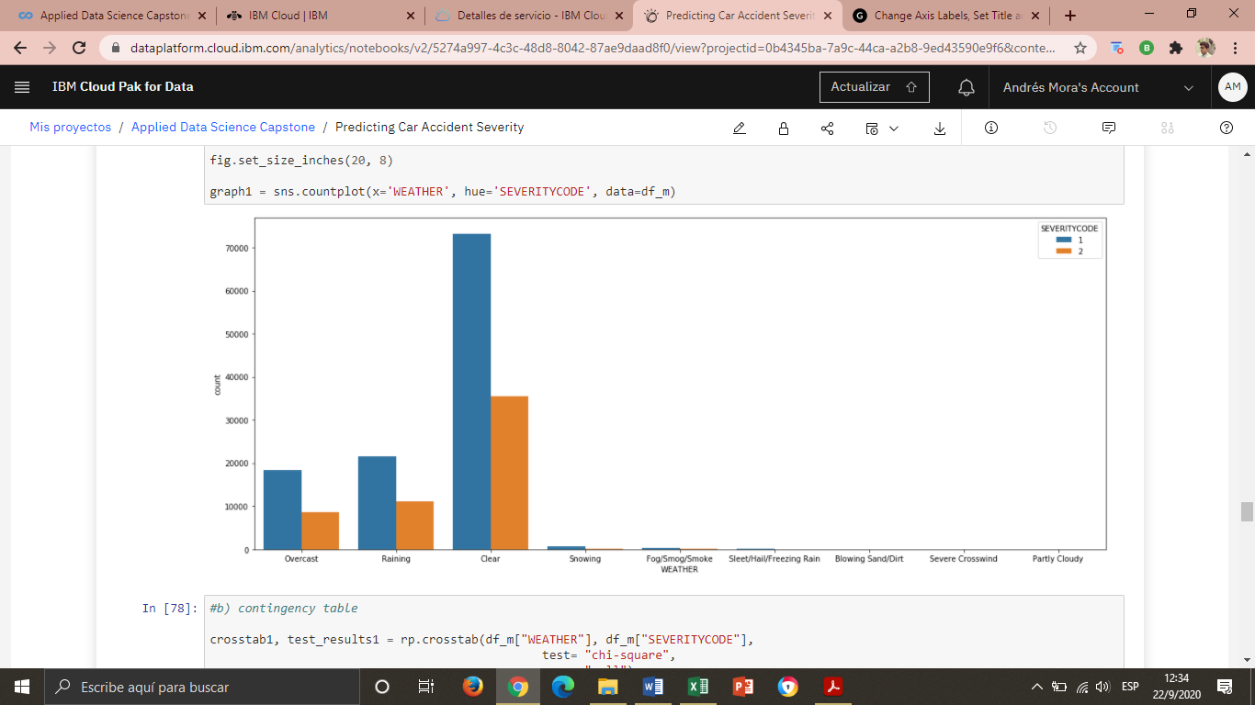
RESULTS: ‘Weather’
1. Relationship between CAR ACCIDENT SEVERITY and WEATHER
Almost all data is concentrated under ‘Clear’ weather.
Differences of severity only happen in the three top labels
The majority of accidents point a low score in severity: only property damage.

Slide 6
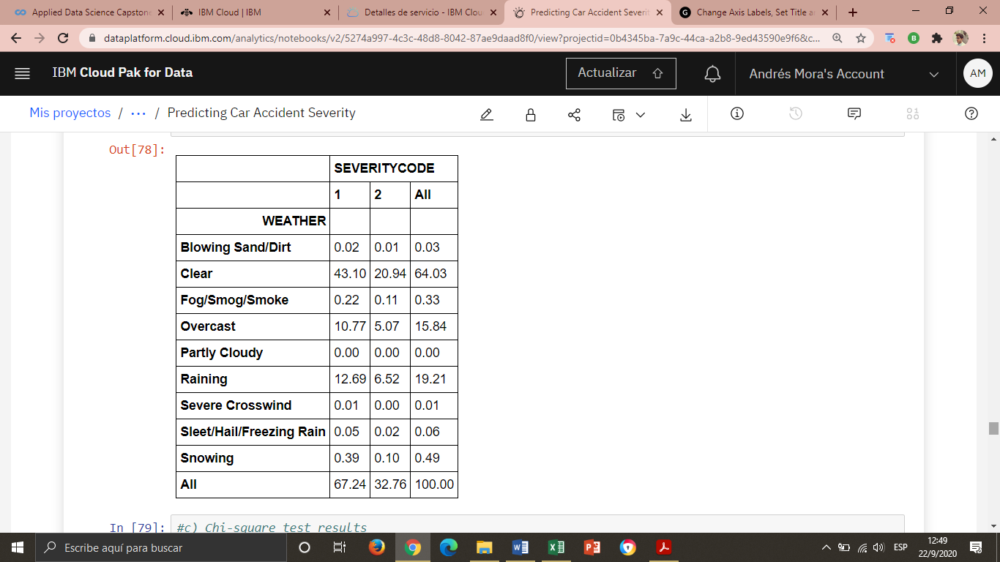
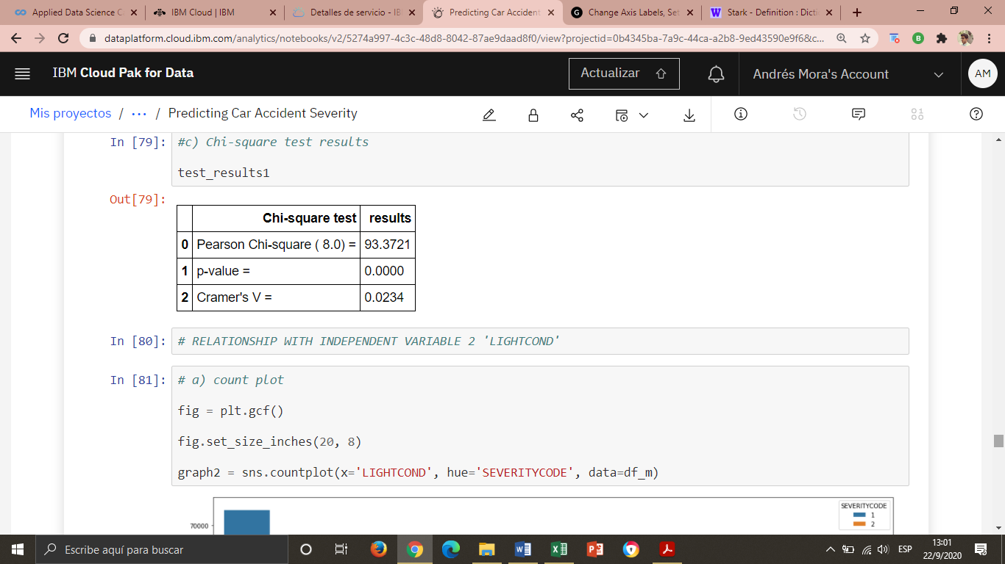
RESULTS: ‘Weather’
1. Relationship between CAR ACCIDENT SEVERITY and WEATHER
64,03% of car accidents occur under ‘Clear’ weather: 2/3 correspond to property damage severity, and 1/3 to injury severity. Differences of severity only happen in the three top labels
The correlation metrics show a very weak association.

Slide 7
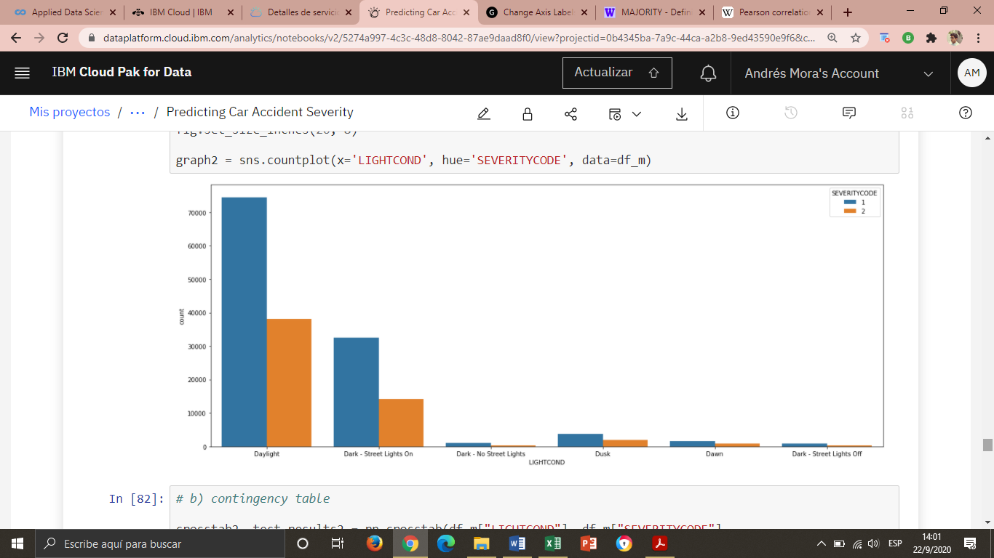
RESULTS: ‘Lightning conditions’
2. Relationship between CAR ACCIDENT SEVERITY and LIGHTING CONDITIONS
Almost all data is concentrated under ‘Daylight’
Differences of severity only happen in the top two labels
The majority of accidents point a low score in severity: only property damage.

Slide 8
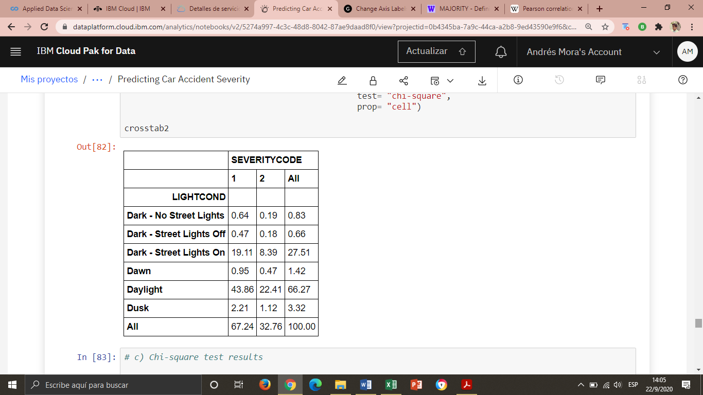
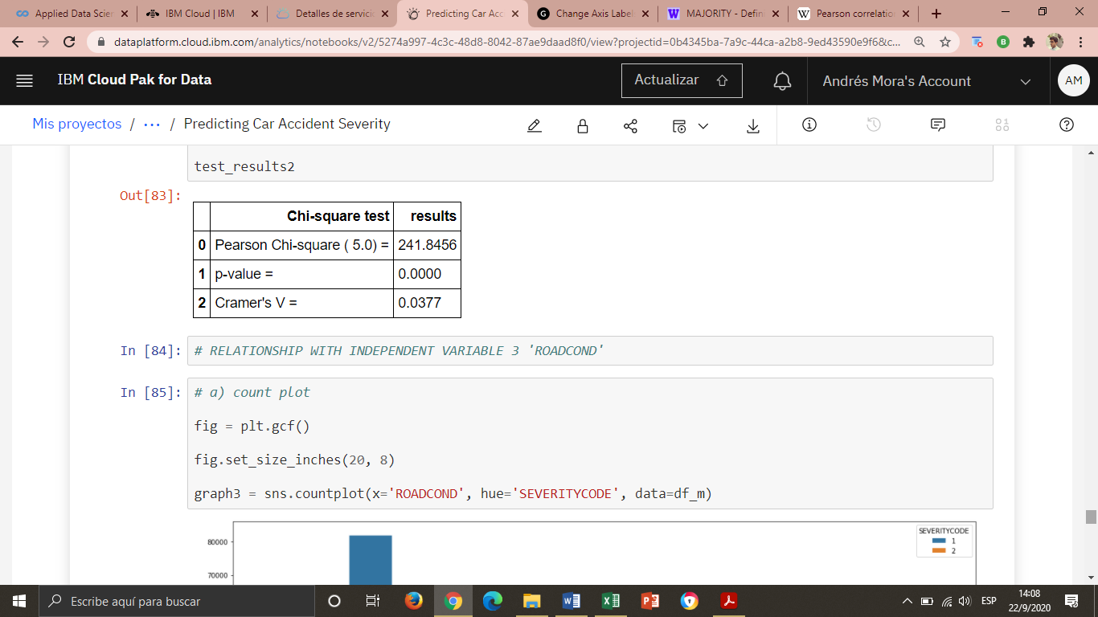
RESULTS: ‘Lightning conditions’
2. Relationship between CAR ACCIDENT SEVERITY and LIGHTING CONDITIONS
66,27% of car accidents occur under ‘Daylight’: 2/3 correspond to property damage severity, and 1/3 to injury severity. Differences of severity only happen in the three top labels
The correlation metrics show a very weak association.

Slide 9
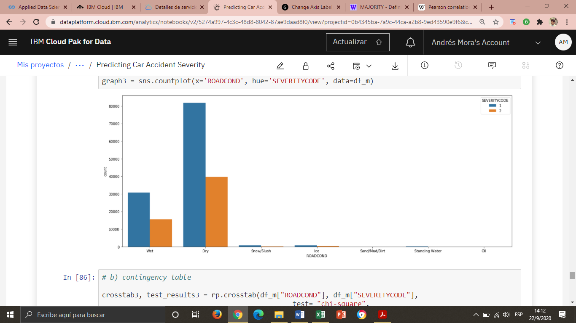
RESULTS: ‘Road conditions’
3. Relationship between CAR ACCIDENT SEVERITY and ROAD CONDITIONS
Almost all data is concentrated under ‘Dry’ road conditions
Differences of severity only happen in the top two labels
The majority of accidents point a low score in severity: only property damage.

Slide 10
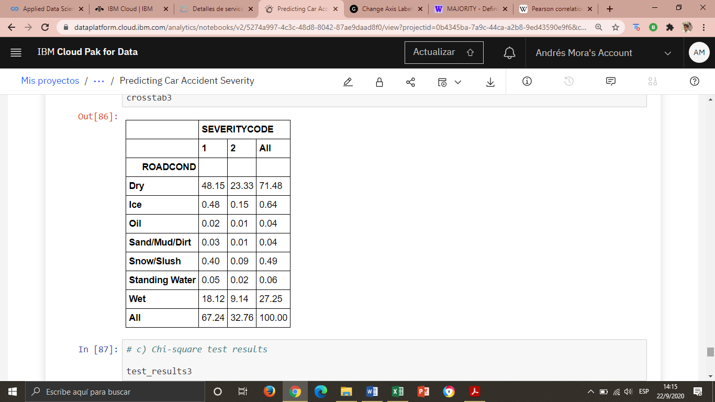
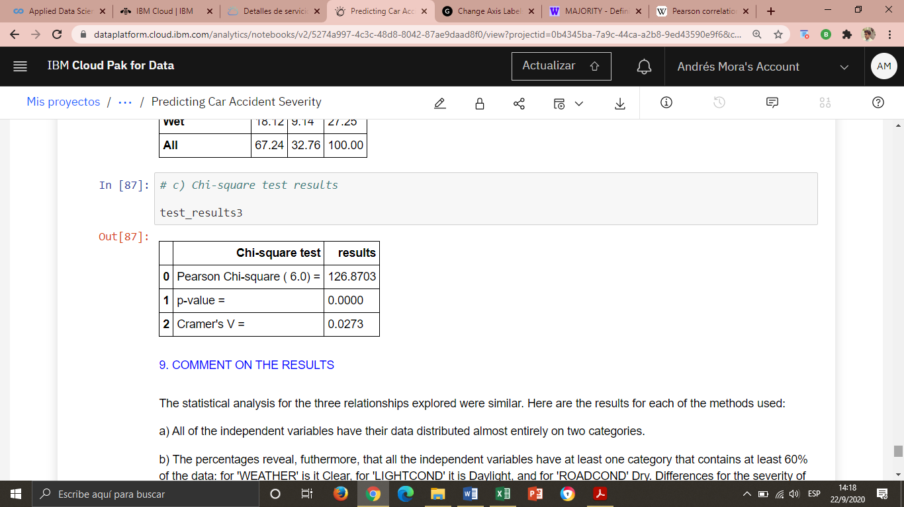
RESULTS: ‘Road conditions’
3. Relationship between CAR ACCIDENT SEVERITY and ROAD CONDITIONS
71,48% of car accidents occur under ‘Dry’ road conditions: 2/3 correspond to property damage severity, and 1/3 to injury severity. Differences of severity only happen in the three top labels
The correlation metrics show a very weak association.

Slide 11
DISCUSSION
CATEGORICAL ANALYSIS: results brief
a) visualizing frequencies
b) obtaining distribution percentages
Almost all of the data is distributed under one label.
All the environmental variables have at least one category that contains at least 60% of the data: for 'Weather' it is Clear, for 'Light Conditions' it is Daylight, and for 'Road Conditions' Dry.
Differences for the severity occur only in top labels of each variable
c) applying categorical correlation metrics
The metrics show a very weak relationship.

Slide 12
CONCLUSION
1) None of the environmental variables displayed a significant relationship predicting the severity of a car accident: no predictive model can be obtained out of them.
2) The great majority of car accidents happen under “normal” environmental conditions: clear weather, daylight, dry road. The Seattle, WA jurisdiction registered no car accident severity above “injury”. This suggests that car accidents happening in this jurisdiction are not severe and that such severity is not connected to environmental conditions
3) The severity of car accident might have to be studied regarding human and/or machine related variables

